Slide 1


USE CASE #7
Digital Automation of Container Inventory Results
Avinash Hipparagi
Jeelkumar Langalia
Prakhar Srivastava
Rohit Venkatesh
Subhiksha Arcot Praburam

Slide 2




Current Situation
Record
Report
Manually notes container numbers and quantities .
Final summary is prepared in Excel format for reporting.
Inspect
Digitize
Employee enters container area and records data using a paper list.
Data is typed and processed digitally

Slide 3
Proposed Solution
Validate
All listed containers are cross-checked; new ones can be added manually.
Capture
Digitize
Employee enters container quantities using a digital device on-site.
Data is saved and automatically stored or forwarded to the controller.

Slide 4

Improving inventory process by 3x
Record
Report
Validate
Manually notes container numbers and quantities .
Final summary is prepared in Excel format for reporting.
All listed containers are cross-checked; new ones can be added manually.
Inspect
Digitize
Capture
Digitize
Employee enters container area and records data using a paper list.
Data is typed and processed digitally
Employee enters container quantities using a digital device on-site.
Data is saved and automatically stored or forwarded to the controller.
Current Situation
Goal

Slide 5
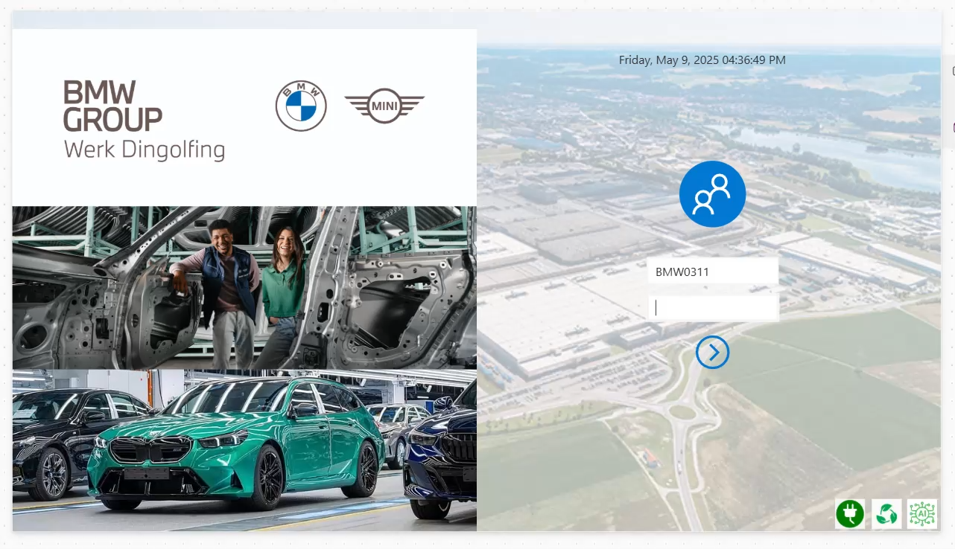

Slide 6


Future Improvements
AI Image Recognition
Voice Command Recognition with Copilot
Use cameras to detect and count containers
Auto-verify container type, quantity, and condition
High potential for full process automation
Leverage Microsoft Copilot to input container data using voice commands
AI transcribes spoken container ID and quantity directly into the app
Enables fast, hands-free data entry

Slide 7


Future Improvements
AI Image Recognition
Voice Command Recognition with Copilot
Barcode Integration
RFID Tracking
Replace manual entry with barcode scanning
Instant container ID input using device camera
Quick to deploy within existing Power Apps
Leverage Microsoft Copilot to input container data using voice commands
AI transcribes spoken container ID and quantity directly into the app
Enables fast, hands-free data entry
Contactless scanning of multiple containers
Enables faster, bulk data capture
Ideal for mid-term automation scale-up
Use cameras to detect and count containers
Auto-verify container type, quantity, and condition
High potential for full process automation

Slide 8








Solution Architecture
SharePoint
Power Apps
Document management and storage foundation
Custom business applications without code
Power Automate
Dataverse
Workflow automation between services
Secure data storage for business applications

